Slide 1

US Accidents Analysis
2016 - 2021
A Countrywide Traffic Accident Dataset
December 2022
US Accidents Analysis
US Accidents Analysis
Sydney Lieske & Isabella Morales

Slide 2
Introduction
This project is an analysis of the US Accidents dataset which covers 49 states of the USA. The data is from Feb. 2016 to Dec. 2021 which is collected from multiple APIs that stream traffic incident data.
With these APIs, they broadcast the traffic data captured by various entities such as the US and state DoT, traffic cameras and sensors within road-networks, and law enforcement agencies. Currently, there are about 2.8 million accident records in this dataset.
Notes:
Syd
We chose this dataset because of how prominent vehicle accidents are within our everyday lives.
Crashes that occur impact not only everyone involved, but also those around. We wanted to look at these statistics to understand what causes and what things can be done in order to prevent the number of crashes that occur in a year.

Slide 3
Motivation & Goals
The objective of our data analysis on U.S. accidents was done in order to find preventative measures. Preventative measures can afterwards be used in order to reduce the amount of accidents that occur. Understanding this dataset would allow for the ability to limit the amount of crashes that occur during a year
The US Accidents dataset, can be used for real-time car accident prediction, casualty analysis, studying the impact of environmental stimuli on the occurrence of accidents, and even car accident hotspot locations. It also can be used to study the Covid-19 pandemic on traffic accidents and behavior
Notes:
isa

Slide 4
Research Questions
What is the distribution of accidents across the country?
Which states have the most cases of accidents? Least?
Which streets are the most accident prone?
Which months have the most accidents?
What time and day are safer to travel?
What factors are most responsible for these accidents?
During what weather conditions do the most accidents occur?
What can be implemented to help reduce these accidents?
How could these accidents be minimized?
What kind of IoT devices were used to report the incidents?
Was an ATMS used?
Notes:
syd

Slide 5
Analysis Plan
Research
Data cleaning
Analyzing data
Location
Time
Road Conditions
Weather
R / Python
Rstudio
Google Colab notebooks
Notes:
syd

Slide 6
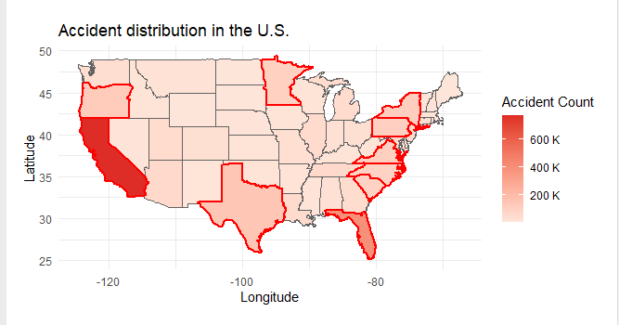
Accident Distribution
Notes:
syd

Slide 7
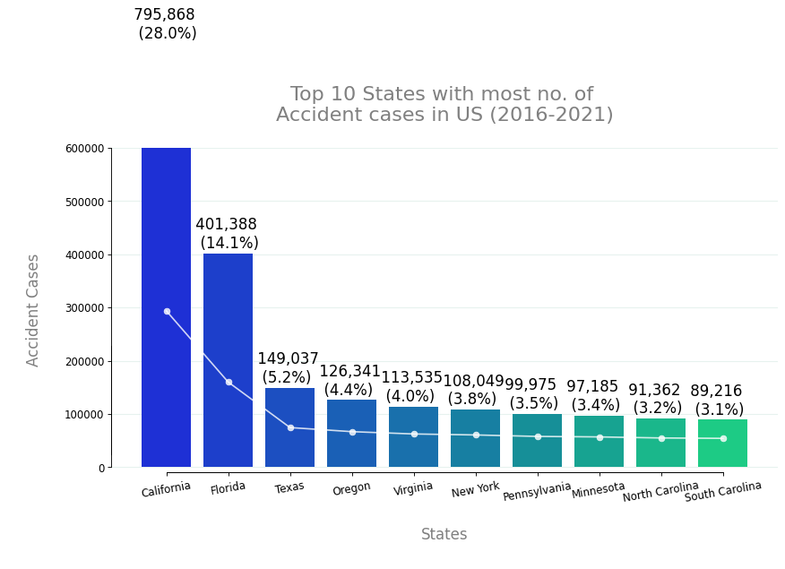
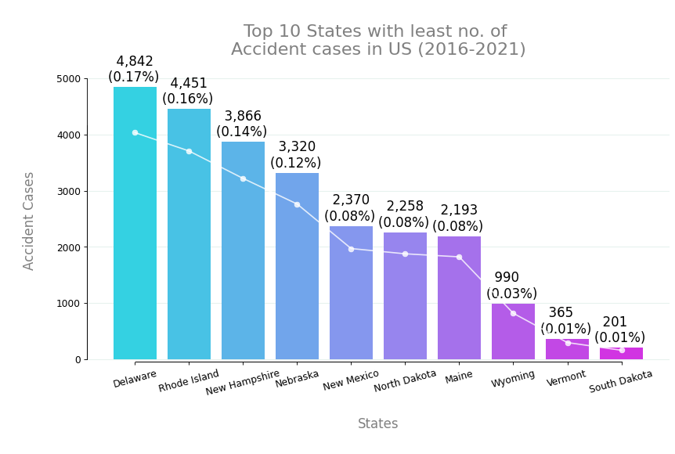
Top 10 States
Notes:
syd

Slide 8
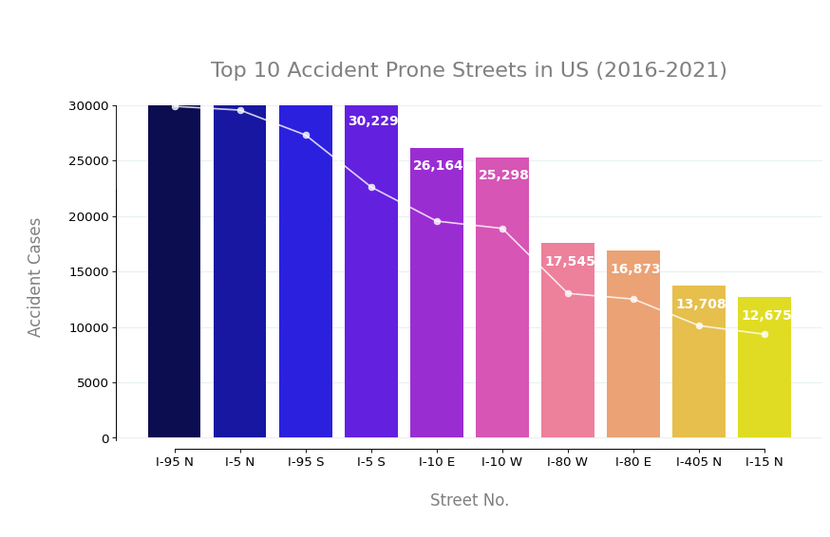
Analysis
Notes:
syd

Slide 9
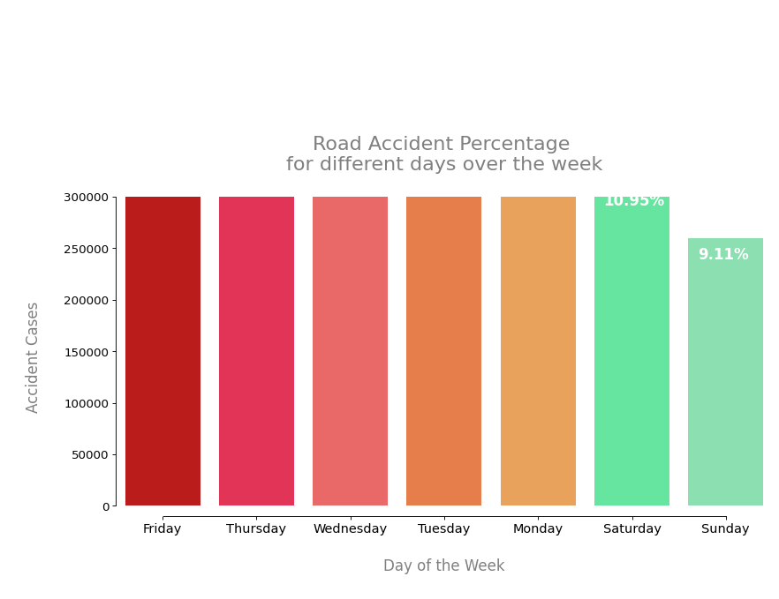


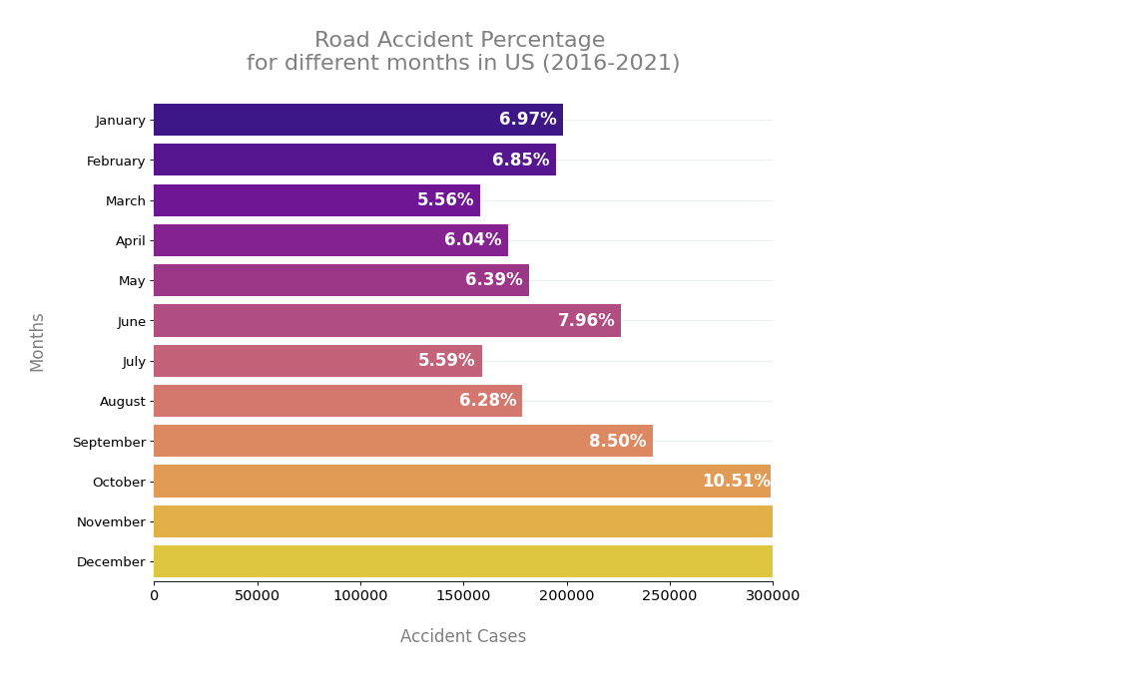
Road Accidents
Road Accidents Months
Road Accidents Week
Notes:
syd

Slide 10
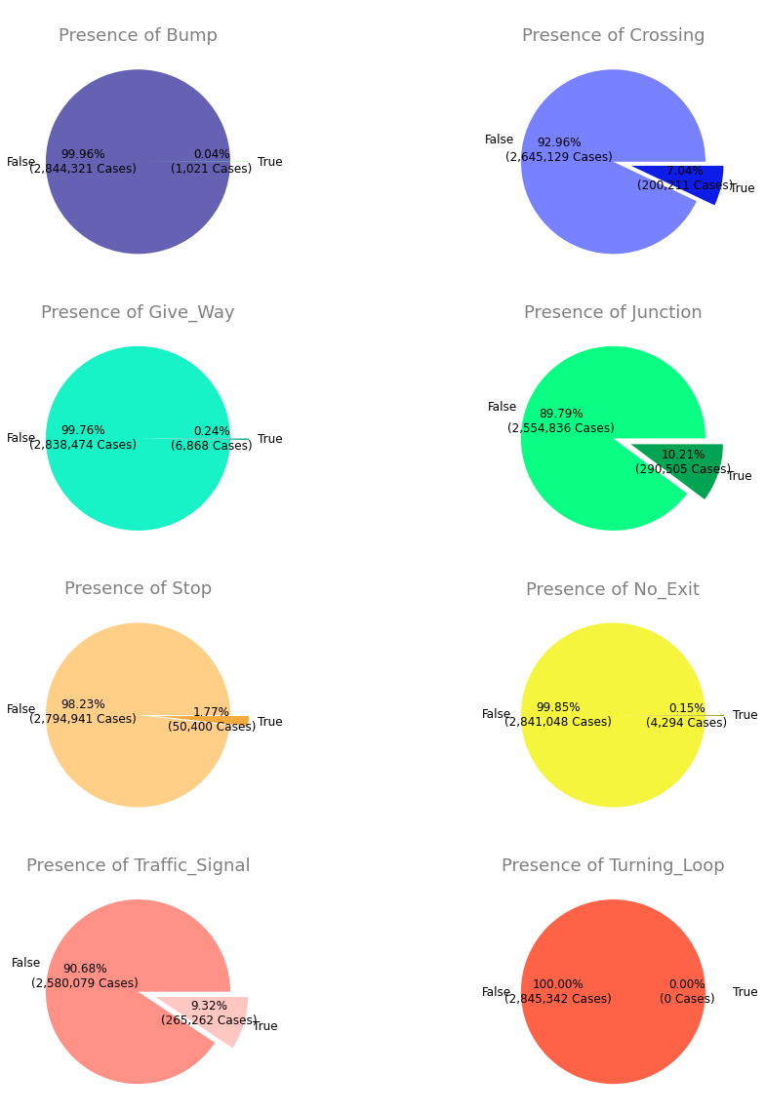
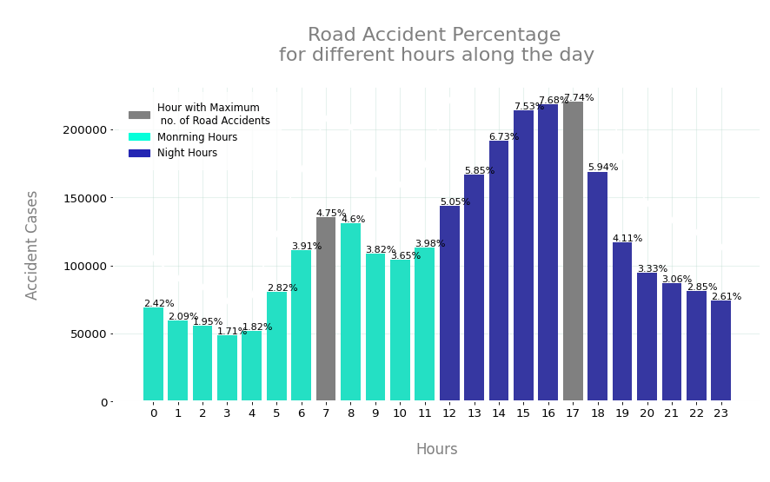
Analysis
Notes:
syd

Slide 11
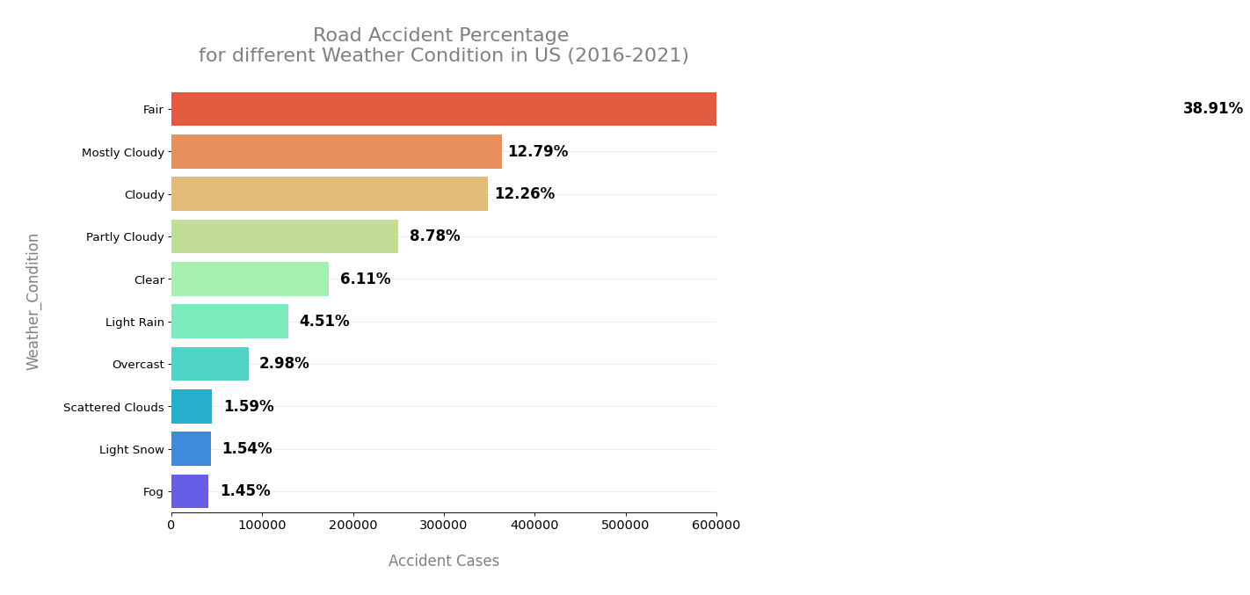
Weather Analysis
Notes:
syd

Slide 12
Results & Conclusion
Through the analysis of our chosen dataset, we were able to answer a majority of our research questions such as:
Fridays are the most accident prone with cases at 17.29%, vs Sundays 9.11%, the lowest of the days of the week. Hours 3-5pm are the most in the evening time with 5pm being the highest, and 6-8am with 7am at the most in the morning.
The presence of traffic signals are just one of the preventive measures that we were able to analyze within this data set.
Accidents occur more on highways or state road than on local streets, preventive measures like speed limits
Roadside messages and if the vehicles are equipped with ADAS would help to minimize accidents.
Notes:
isa

Slide 13
Sources for Dataset
Using the dataset:
Moosavi, Sobhan, Mohammad Hossein Samavatian, Srinivasan Parthasarathy, and Rajiv Ramnath. “A Countrywide Traffic Accident Dataset.”, 2019.
Moosavi, Sobhan, Mohammad Hossein Samavatian, Srinivasan Parthasarathy, Radu Teodorescu, and Rajiv Ramnath. "Accident Risk Prediction based on Heterogeneous Sparse Data: New Dataset and Insights." In proceedings of the 27th ACM SIGSPATIAL International Conference on Advances in Geographic Information Systems, ACM, 2019.
Notes:
isa

Slide 14
Questions

